Slide 1
Huawei OceanStor 100D Distributed Storage Architecture and Technical Principles
Department:
Prepared By:
Date: Feb., 2020
Security Level: Internal only

Slide 2
About This Document
Overview
This document introduces Huawei's new-gen intelligent distributed storage of OceanStor 100D (originally referred to as FusionStorage) in terms of architecture design concepts, key technical principles, and technical competitiveness.
This document covers some capabilities listed on the roadmap. For project development, you also need to refer to the corresponding Technical Specifications List.
Intended audience
Huawei data storage sales engineers, frontline product managers, marketing personnel, and those from peripheral domains of R&D.
Objective
To have a deep understanding of OceanStor 100D's design concepts, key technical principles, and technical competitiveness, which helps build an expert image during customer communication
Version and date
V1.0, 2020-02-10
Hide this page before use.

Slide 3
OceanStor 100D
Block+File+Object+HDFS
Ultimate Performance
Ultimate Usability
Scenario and Ecosystem
Overview
Ultimate Efficiency
Ultimate Reliability
Hardware
Ecosystem

Slide 4


































Typical Application Scenarios of Distributed Storage
Virtual storage pool
HDFS
HPC/Backup/Archival
Traditional compute-storage convergence
Tiered data migration/backup to the cloud
Cloud service
HDFS
Public and private cloud
BSS
OSS
MSS
One storage system for HPC data lifecycle management
Tiering to UHD storage
UHD
Data node +
Compute node
Data node +
Compute node
Data node +
Compute node
Ethernet
Hot data
Warm data
Cold data
HPC production storage
SSD to HDD tiering
HPC backup storage
Storage archival
Data node +
Compute node
Data node +
Compute node
Data node +
Compute node
Tiered storage of cold data
VM
...VM
VM
Tiered storage from file to object service
HPC full data lifecycle management
Storage-compute separation
Cloud storage resource pool
Compute node
Ethernet
Compute node
Compute node
File storage
VM
Application
Database service
Cloud storage resource pool
Backup/Archive software
Data node
Data node
Data node
Public cloud
Cloud storage resource pool
Storage space pooling and on-demand expansion, reducing initial investment
Ultra-large VM deployment
Zero data migration and simple O&M
Storage-compute separation, implementing elastic compute and storage scaling
EC technology, achieving higher utilization than the traditional Hadoop three-copy technology
TCO reduced by 40%+ compared with the traditional solution
HPC meets requirements for high bandwidth and intensive IOPS. Cold and hot data can be stored together.
Backup and archival, on-demand purchase, and elastic expansion
Server-storage convergence, reducing TCO by 40%+

Slide 5
Core Requirements for Storage Systems
Distributed Storage Hot Issue Statistics
Scalability
60.7%
60.1%
58.2%
56.6%
51.5%
50.8%
47.3%
36.4%
Performance
Usability
Users'
core requirements
High scalability
Reliability
I/O performance
Usability
Cost
Hotspot performance
Data security
Features
Reliability
Source: 130 questionnaires and 50 bidding documents from carriers, governments, finance sectors, and large enterprises
Cost

Slide 6
Current Distributed Storage Architecture Constraints
Mainstream open-source software in the industry
Mainstream commercial software in the industry
Three steps to query the mapping: LUNs or files are mapped to multiple continuous objects on the local OSD.
User LUN/File
Obj
Obj
Obj
Obj
Obj
Obj
Obj
Obj
Obj
Obj
Obj
Protection groups (PGs) have a great impact on system performance and layout balancing. They need to be dynamically split and adjusted based on the storage scale. This adjustment affects system stability.
Obj
PG
PG
PG
PG
PG
PG
PG
PG
PG
PG
PG
PG
PG
PG
PG
PG
PG
PG
PG
PG
CRUSH map
The minimum management granularity is by object. The size of an object is adjustable, which affects metadata management, space consumption, performance, and even read/write stability.
OSD
OSD
OSD
OSD
Local storage
obj
File
Disk
ID
Binary Data
Metadata
Performance | The CRUSH algorithm is simple, but does not support RDMA, and the performance for small I/Os and EC is poor. | Multiple disks form a disk group (DG). One DG is configured with one SSD cache. Heavy I/O loads will trigger cache writeback, greatly deteriorating performance.
Reliability | Design-based CRUSH algorithm constraints: uneven data distribution, uneven disk space usage, and insufficient subhealth processing | Data reconstruction in fault scenarios has a great impact on performance.
Scalability | Restricted by the CRUSH algorithm, adding nodes costs high, and large-scale capacity expansion is difficult. | Poor scalability: Only up to 64 nodes are supported.
Usability | Lack of cluster management and maintenance interfaces with poor usability | Inherit the vCenter management system with high usability.
Cost | Community product with low cost: EC is not used for commercial, and deduplication and compression are not supported | High cost: All SSDs support intra-DG deduplication and non-global deduplication, but do not support compression. EC supports only 3+1 or 4+2.

Slide 7
Overall Architecture of Distributed Storage (Four-in-One)
VBS (SCSI/iSCSI)
NFS/SMB
HDFS
S3/SWIFT
Disaster Recovery
HyperReplication
HyperMetro
O&M Plane
Cluster Management
DeviceManger
QoS
License/Alarm/
Log
Authentication
eService
Block
LUN Volume
L1 Cache
File
DriectIO L1 Cache MDS
HDFS
NameNode
Object
LS OSC Billing
Index Layer
Write Ahead Log Snapshot Compression Deduplication Garbage Collection
Persistence Layer
Mirror Erasure Coding Fast Reconstruction Write-back Cache SmartCache
Hardware
x86 Kunpeng
Architecture advantages
Convergence of the block, object, NAS, and HDFS services, implementing data flow and service interworking
Introducing advantages of the professional storage to achieve optimal convergence of performance, reliability, usability, cost, and scalability
Convergence of software and hardware, optimizing performance and reliability based on customized hardware

Slide 8
OceanStor 100D
Block+File+Object+HDFS
Ultimate Performance
Ultimate Usability
Scenario and Ecosystem
Overview
Ultimate Efficiency
Ultimate Reliability
Hardware
Ecosystem

Slide 9
Data Routing, Twice Data Dispersion, and Load Balancing Among Storage Nodes
Front-end NIC
User Data
Basic Concepts
Node: physical node, that is, a storage server
Vnode: logical processing unit. Each physical node is divided into four logical processing units. When a physical node becomes faulty, services processed by the four vnodes on the faulty node can be taken over by the other four physical nodes in the cluster. In this case, service takeover efficiency and load balancing can be improved.
Partition: A fixed number of partitions are created in the storage resource pool. Partitions are also units for capacity expansion, data migration, and data reconstruction.
Plog: partition log for data storage, providing the read/write interface for Append Write Only services. The size of a Plog is not fixed. It can be 4 MB or 32 MB, and the maximum size is 4 GB. The Plog size, redundancy policy, and partition where data is stored will be specified during service creation. When creating a Plog, select a partition based on load balancing and capacity balancing.
...
N1
SLICE
Front-end module for data dispersion
(first)
N7
DHT loop
N2
N6
N3
N5
N4
vnode
vnode
Data processing module
vnode
vnode
Node
Plog 1
Plog 2
Plog 3
Data storage module for data dispersion
(second)
...
Partition 01
Partition 02
SSD/HDD
Partition 03
Node
Node-0
Node-1
Node-2
Node-3

Slide 10
I/O Stack Processing Framework
The I/O channels are divided into two phases:
Host I/O processing (① red line): After receiving data, the storage system stores one copy in RAM cache and three copies in SSD WAL cache of three storage nodes. After the copies are successfully stored, a success response is returned to the upper-layer application host. The host I/O processing is complete.
Background I/O processing (② blue line): When data in the RAM cache reaches a certain amount, the system calculates large data blocks using EC and stores generated data fragments onto HHDs. (③ Before data is stored onto HDDs, the system determines whether to send data blocks to the SSD cache based on the data block size.)
①
RAM cache
Data
Parity
Erasure Coding
②
SSD WAL cache
SSD cache
③
HDD
Node-1
Node-2
Node-3
Node-4
Node-5
Node-6

Slide 11
Storage Resource Pool Principles and Elastic EC
EC: erasure coding, a data protection mechanism. It implements data redundancy protection by calculating parity fragments. Compared with the multi-copy mechanism, EC has higher storage utilization and significantly reduces costs.
EC redundancy level: N+M = 24 (M = 2 or 4), N+M = 23 (M = 3)
Node 1
Node 2
Node 3
EC 4+2 Partition Table
Partition No. | Mem1 | Mem2 | Mem3 | Mem4 | mem5 | mem6
Partition1 | node1 Disk1 | node1 Disk3 | node2 Disk7 | node2 Disk4 | node3 Disk6 | Node3 Disk4
Partition2 | node1 Disk10 | Node3 Disk11 | node1 Disk1 | node3 Disk5 | node2 Disk3 | Node2 Disk2
...
Partition | node3 Disk10 | node2 Disk11 | node1 Disk1 | node3 Disk5 | node1 Disk3 | Node2 Disk2
Disk
Disk
Disk
Disk
Disk
Disk
Disk
Disk
Disk
Disk
Disk
Disk
Disk
Disk
Disk
Disk
Disk
Disk
Disk
Disk
Disk
Disk
Disk
Disk
Disk
Disk
Disk
Disk
Disk
Disk
Basic principles:
When a storage pool is created using disks on multiple nodes, a partition table will be generated. The number of rows in the partition table is 51200 x 3/(N+M), and the number of columns is (N+M). All disks are filled in the partition table as elements based on the reliability and partition balancing principles.
The mapping between partitions and disks is N:M. That is, a disk may belong to multiple partitions, and a partition may have multiple disks.
Partition balancing principle: Number of times that each disk appears in the partition = Number of times that each disk appears in memory
Reliability balancing principle: For node-level security, the number of disks on the same node in a partition cannot exceed the value of M in EC N+M.

Slide 12
EC Expansion Balances Costs and Reliability
As the number of nodes increases during capacity expansion, the number of data blocks (the value of N in EC) automatically increases, with the reliability unchanged and space utilization improved.
EC 2+2
EC (N+2) |  | EC (N+3) |  | EC (N+4)
Redundancy Ratio | Space Utilization | Redundancy Ratio | Space Utilization | Redundancy Ratio | Space Utilization
2+2 | 50.00% | 6+3 | 66.66% | 6+4 | 60.00%
4+2 | 66.66% | 8+3 | 72.72% | 8+4 | 66.66%
6+2 | 75.00% | 10+3 | 76.92% | 10+4 | 71.43%
8+2 | 80.00% | 12+3 | 80.00% | 12+4 | 75.00%
10+2 | 83.33% | 14+3 | 82.35% | 14+4 | 77.78%
12+2 | 85.71% | 16+3 | 84.21% | 16+4 | 80.00%
14+2 | 87.50% | 18+3 | 85.71% | 18+4 | 81.82%
16+2 | 88.88% | 20+3 | 86.90% | 20+4 | 83.33%
18+2 | 90.00%
20+2 | 90.91%
22+2 | 91.67%
Data blocks (2)
Parity blocks (2)
Ascending
...
EC 22+2
Data blocks (22)
Parity blocks (2)
When adding nodes to the storage system, the customer can determine whether to expand the EC. Using EC expansion can increase the number of data blocks (M) and improve the space utilization, with the number of parity blocks (M) and reliability unchanged.

Slide 13
EC Reduction and Read Degradation Optimize Reliability and Performance
Data Read in EC 4+2
Data Write in EC 4+2
Data
Data
Original data
Parity data
Process
(EDS)
EC decoding
Process (EDS)
EC encoding
2+2
Original data
Parity data
2+2
Disk1
Disk2
Disk 3
Disk 4
Disk 5
Disk 6
Disk1
Disk2
Disk3
Disk4
Disk5
Disk6
The EC can reconstruct valid data and return the data only after read degradation and verification decoding are performed.
The reliability of data stored in EC mode decreases if a node becomes faulty. The reliability needs to be recovered through data reconstruction.
If a fault occurs, using EC reduction to write data can ensure the data write reliability. Assume that the original EC scheme is 4+2, when a fault occurs, the data will be written to the storage system in EC 2+2 mode.
EC never degrades write operation, providing higher reliability.

Slide 14
High-Ratio EC Aggregates Small Data Blocks and ROW Balances Costs and Performance
LUN 0
LUN 1
LUN 2
...
4 KB
...
...
4 KB
4 KB
8 KB
4 KB
8 KB
4 KB
4 KB
8 KB
I/O aggregation
Linear space
A
B
C
D
E
...
Data Write
Plog
Data storage using Append Only Plog (ROW-based append write technology for I/O processing)
A
B
C
D
E
Full stripe
P
Q
Node-0
Node-1
Node-2
Node-3
Node-4
Intelligent stripe aggregation algorithm + log appending: Reduces latency and achieves a high ratio of EC 22+2
Host write I/Os are aggregated into full EC stripes based on the write-ahead log (WAL) mechanism for system reliability.
The load-based intelligent EC algorithm writes data to SSDs in full stripes, reducing write amplification and ensuring the host write latency less than 500 μs.
The mirror relationship is created between the data in the Hash memory table and that in SSD media logs. After data is aggregated, random write is changed to 100% sequential write which writes data to back-end media, improving random write efficiency.

Slide 15
Inline and Post-Process Adaptive Deduplication and Compression
Opportunity
table
Data with low deduplication ratios is filtered out by using the opportunity table.
OceanStor 100D supports global deduplication and compression, as well as adaptive inline and post-process deduplication. Deduplication reduces write amplification of disks before data is written to disks. Global adaptive deduplication and compression can be performed on all-flash SSDs and HDDs.
OceanStor 100D uses the opportunity table and fingerprint table mechanism. After data enters the cache, the data is broken into 8 KB data fragments. The SHA-1 algorithm is used to calculate 8 KB data fingerprints. The opportunity table is used to reduce invalid fingerprint space.
Adaptive inline and post-process deduplication: When the system resource usage reaches the threshold, inline deduplication automatically stops. Data is directly written to disks for persistent storage. When system resources are idle, post-process deduplication starts.
Before data is written to disks, the system enters the compression process. The compression is aligned in the unit of 512 bytes. The LZ4 algorithm is used and deep compression HZ9 is supported.
If inline deduplication fails or is skipped, post-process deduplication is enabled and data block fingerprints enter the opportunity table.
Block 1
HASH-B
3
Block 2
Block 3
HASH-C
4
Promote the opportunity table to a fingerprint table.
Write data blocks.
Media Type | Service Type | Deduplication and Compression | Impact on Performance
All-flash SSDs | Bandwidth-intensive services | Deduplication and compression enabled | Reduced by 30%
 | IOPS-intensive services | Deduplication and compression enabled | Reduced by 15%
 | Bandwidth-intensive services | Compression enabled only | Pure write increased by 50% and pure read increased by 70%
 | IOPS-intensive services | Compression enabled only | Reduced by 10%
HDDs | Bandwidth-intensive services | Compression enabled only | Pure write increased by 50% and pure read increased by 70%
 | IOPS-intensive services | Compression enabled only | None
1
Direct data in the fingerprint table after post-process deduplication.
Block1
5
Fingerprint
table
Block 2
Block 3
HASH-B
Block B
The fingerprint table occupies a little memory, which supports deduplication of large-capacity systems.
Block 4
HASH-A
Block 5
Direct data in the fingerprint table after inline deduplication.
Block A
2

Slide 16
Post-Process Deduplication
Node 0
Node 1
Deduplication
Data service
Deduplication
Data service
Opportunity table
2. Injection
Opportunity table
1. Preparation
4. Raw data read
Address mapping table
3. Analysis
Address
mapping
table
Fingerprint
data table
5. Promotion
Fingerprint
data table
6. Remapping
7. Garbage collection

Slide 17
Inline Deduplication Process
1. DSC cache destage
EDS process on Node 0
EDS process on Node 1
Deduplication
Data service
Deduplication
Data service
Opportunity table
Opportunity table
2. Looking up fingerprint for inline deduplication
Address
mapping
table
Address mapping table
FPCache
Returned result
Fingerprint
data table
Fingerprint
data table
3. Writing fingerprint instead of data

Slide 18
Compression Process
After deduplication, data begins to be compressed. After compression, the data begins to be compacted.
Data compression can be enabled or disabled as required based on the LUN/FS granularity.
The following compression algorithms are supported: LZ4 and HZ9. HZ9 is a deep compression algorithm and its compression ratio is 20% higher than that of LZ4.
The length of the compressed data varies. Multiple data blocks less than 512 bytes can be compacted, and then stored and aligned in the storage space. If the compressed data is not in 512-byte aligned mode, zeros will be added to improve the space utilization.
I/O data
1. Breaking data into a fixed length
Data of the same size
2. Compression
Data after compression
B1
B2
B3
B4
B5
Typical data layout
in storage
512 bytes
1.5 KB
2.5 KB
3.5 KB
4.5 KB
5 KB
Waste space
512 bytes aligned, wasting a lot of space
B1
B2
B3
B4
Compression header, which describes the start and length of compressed data
B5
OceanStor 100D data layout
3. Data compaction
512 bytes
1.5 KB
2.5 KB
3 KB

Slide 19
Ultra-Large Cluster Management and Scaling
Compute
cluster
Adding/Reducing compute nodes
Compute node
Compute node
Compute node
Compute node
Compute node: 10,240 nodes supported by TCP, 100 nodes supported by IB, and 768 nodes supported by RoCE
VBS
VBS
VBS
VBS
Network switch
Storage node
Storage node
Storage node
Storage node
Storage node
Control
cluster
Adding/Reducing ZK disks
ZK
ZK
ZK
ZK
ZK
Nine nodes supported by ZK
Storage
pool
Adding/Reducing storage nodes
Disk
Disk
Disk
Disk
Disk
Storage node: node/cabinet-level capacity expansion
Adding/Deleting nodes in the original storage pool and creating a storage pool for new nodes
Disk
Disk
Disk
Disk
Disk
Disk
Disk
Disk
Disk
Disk
Adding disks
Disk
Disk
Disk
Storage node: on-demand disk expansion

Slide 20
All-Scenario Online Non-Disruptive Upgrade (No Impacts on Hosts)
Block mounting scenario:
iSCSI scenario:
Compute node
Host
Before the upgrade, start the backup process and maintain the connection with the shared memory, and complete the upgrade within 5 seconds.
Single-path upgrade is supported. Host connections are not interrupted, but I/Os are suspended for 5 seconds.
Provides only interfaces and forwards I/Os. The code is simplified and does not need to be upgraded.
iSCSI initiator
SCSI
VSC
VBS
Back up the TCP connection.
Connect to the backup process.
VBS
Each node completes the upgrade within 5 seconds and services are quickly taken over. The host connection is uninterrupted, but I/Os are suspended for 5 seconds.
Restore the TCP connection.
Storage node
Storage node
Save the iSCSI connection and I/Os.
Shared memory
EDS
EDS
Restore the iSCSI connection and I/Os.
Component-based upgrade: Components without changes are not upgraded, minimizing the upgrade duration and impact on services.
EDS
OSD
…
OSD
OSD
...
...
...
x

Slide 21
Concurrent Upgrade of Massive Storage Nodes
Application
Application
Application
Application
HDFS
Obj S3
NAS private client
Block VBS
Storage pool 1
Storage pool 2
Disk pool
Disk pool
Disk pool
Disk pool
Storage node
Storage node
Storage node
Storage node
Storage node
Storage node
Storage node
Storage node
Storage node
Storage node
Storage node
Storage node
...
...
...
...
32 nodes
32 nodes
32 nodes
32 nodes
Upgrade description:
A storage pool is divided into multiple disk pools. Disk pools are upgraded concurrently, greatly shortening the upgrade duration of distributed massive storage nodes.
The customer can periodically query and update versions from the FSM node based on the configured policy.
Upgrading compute nodes on a management node is supported. Compute nodes can be upgraded by running upgrade commands.

Slide 22
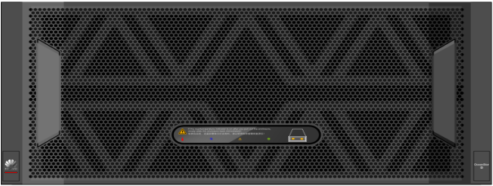


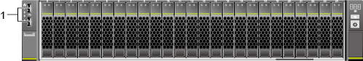
Coexistence of Multi-Generation and Multi-Platform Storage Nodes
Multi-generation storage nodes (dedicated storage nodes of three consecutive generations and general storage nodes of two consecutive generations) can exist in the same cluster but in different pools.
Storage nodes on different platforms can exist in the same cluster and pool.
Coexistence of multi-generation storage nodes in the same cluster
Pacific V1
Pacific V2
Pacific V3
Federation Cluster Network (Data)
TaiShan 200(Model 2280)
(Kunpeng series)
2288H V5
(x86 series)
Coexistence of multi-platform storage nodes in the same cluster

Slide 23
OceanStor 100D
Block+File+Object+HDFS
Ultimate Performance
Ultimate Usability
Scenario and Ecosystem
Overview
Ultimate Efficiency
Ultimate Reliability
Hardware
Ecosystem

Slide 24
CPU Multi-Core Intelligent Scheduling
Group- and Priority-based Multi-Core CPU Intelligent Scheduling
Traditional CPU Thread Scheduling
High-performance Kunpeng multi-core CPU
CORE
CORE
CORE
CORE
CORE
CORE
CORE
CORE
CORE
CORE
CORE
CORE
CORE
CORE
0
1
2
3
5
...
Fast processing and return of front-end I/Os
4
0
1
2
3
4
5
...
Group 1
Group 2
Group 3
Group N
EDS
OSD
EDS
OSD
Front-end thread pool
Communication thread pool
Communication thread pool
Front
Back-end
Meta Merge
Xnet
I/O scheduler
Priority 1
Front
Priority 1
Front
Xnet
Xnet
Replication
Dedup
OSD
Back-end thread pool
Metadata merge thread pool
I/O thread pool
Priority 2
CPU grouping is unavailable, and frequent switchover of processes among CPU cores increases the latency.
CPU scheduling by thread is in disorder, decreasing the CPU efficiency and ultimate performance.
Tasks with different priorities, such as foreground and background tasks, interruption and service tasks, conflict with each other, affecting performance stability.
Back-end
Meta Merge
Xnet
Priority 4
Deduplication thread pool
Replication thread pool
Priority 5
Background I/O adaptive speed adjustment
Dedup
Replication
Advantages of group- and priority-based multi-core CPU intelligent scheduling:
Elastic compute power balancing efficiently adapts to complex and diversified service scenarios.
Thread pool isolation and intelligent CPU grouping reduce switchover overhead and provide stable latency.

Slide 25
Distributed Multi-Level Cache Mechanism
Multi-level distributed read cache
Multi-level distributed write cache
Various multi-level cache mechanisms and hotspot identification algorithms greatly improve performance and reduce latency in hybrid media.

Slide 26
EC Intelligent Aggregation Algorithm
Traditional Cross-Node EC
Intelligent aggregation EC based on append write
LUN 1
LUN 2
LUN 1
LUN 2
A1
A2
A3
A4
......
B1
B2
B3
B4
......
......
A1
A2
A3
A4
......
B1
B2
B3
B4
......
......
Write in place
I/O aggregation unavailable
Small-block write
Performance improved by N times
Append Only and
I/O aggregation
......
Intelligent cache aggregation
B1
A3
B6
......
A1
B1
A3
B6
B9
A5
B5
A8
A1
B9
A5
B5
A8
Stripe1
A1
/
A3
/
P
Q
Supplement read/write A2 and A4.
New Stripe1
A1
B1
A3
B6
P
Q
Stripe2
B1
/
/
/
P
Q
Supplement read/write B2, B3, and B4.
Fixed address mapping cannot wait until data in the same stripe is written to the full stripe at the same time. As a result, the read/write amplification is 2 to 3 times of the full stripe.
New
Stripe2
B9
A5
B5
A8
P
Q
Irrelevant to the write address. Any data written at any time can be aggregated into full stripes without extra amplification.
Stripe3
B6
/
/
B9
P
Q
......
......
Full stripe
New full stripe
A1
A2
A3
A4
P
Q
A1
B1
A3
B6
P
Q
B1
B2
B3
B4
P
Q
B9
A5
B5
A8
P
Q
...
...
...
...
...
...
...
...
...
...
...
...
Node1
Node2
Node3
Node4
Node 5
Node 6
Node 1
Node 2
Node 3
Node 4
Node 5
Node 6
Performance advantages of intelligent aggregation EC based on append write:
Full-stripe EC write can be ensured at any time, reducing read/write network amplification and read/write disk amplification by several times.
Data is aggregated at a time, reducing the CPU compute overhead and providing ultimate peak performance.

Slide 27
Append Only Plog
Disks and new media have great performance differences in different I/O patterns.
Random Write (8 KB) |  |  | Sequential Write (8 KB Aggregation -> Large Size)
Disk Type | Performance | GC Impact | Disk Type | Performance | GC Impact
HDD | 150 IOPS / 1.2 MB/s | / | HDD | 5120 IOPS / 40 MB/s | /
SSD | 40K IOPS / 312 MB/s | Bad | SSD | 153K IOPS / 1200 MB/s | Good
SCM | 200K IOPS / 1562 MB/s | / | SCM | 640K IOPS / 5000 MB/s | /
The Append Only Plog technology provides the optimal disk flushing performance model for media.
Plog is a set of physical addresses that are managed based on a fixed size. The upper layer accesses the Plog by using Plog ID and offset.
Plog is append-only and cannot be overwritten.
......
......
......
Plog has the following performance advantages:
Provides a medium-friendly large-block sequential write model with optimal performance.
Reduces SSD global collection pressure by sequential appending.
Provides a basis for implementing the EC intelligent aggregation algorithm.
A
B
A'
B'
Logical address overwrite
Cache Linear space
A
B
C
D
A'
E
F
B'
......
Data Write
Plog ID + offset
Write new Plogs in appending mode.
Physic address space
Plog 1
Plog 2
Plog 3
......

Slide 28
RoCE+AI Fabric Network Provides Ultra-Low Latency
Compute
nodes
read
write
Front-end service network
Block/NAS private client: RoCE
Standard object protocol: S3
Standard HDFS protocol: HDFS
Standard block protocol: iSCSI
Standard file protocol: NAS/SMB
25 Gbit/s TCP/IP 100 Gbit/s RoCE
Front-end NIC
Front-end NIC
Front-end NIC
Front-end NIC
Back-end storage network
Block/NAS/Object/HDFS: RoCE
AI fabric intelligent flow control: Precisely locates congested flows and implements backpressure suppression without affecting normal flows. The waterline is dynamically set to ensure the highest performance without packet loss. The switch and NIC collaborate to schedule the maximum quota for congestion prevention. The fluctuation rate of the network latency is controlled within 5% without packet loss. The latency is controlled within 30 µs.
Binding links doubles the network bandwidth.
Storage Controller
Storage Controller
Storage Controller
Storage Controller
Storage
nodes
SSD/HDD
Back-end NIC
SSD/HDD
Back-end NIC
SSD/HDD
Back-end NIC
SSD/HDD
Back-end NIC
100 Gbit/s RoCE + AI Fabric

Slide 29
Block: DHT Algorithm + EC Aggregation Ensure Balancing and Ultimate Performance
I/O
DHT algorithm
DHT algorithm: (LBA/64 MB)%
......
Service Layer
Granularity
(64 MB)
The storage node receives I/O data and distributes the data blocks of 64 MB to the storage node using the DHT algorithm.
Node-1
Node-2
Node-3
Node-4
Node-5
Node-6
Node-7
Grain (e.g. 8 KB)
After receiving the data, the storage system divides the data into 8 KB data blocks of the same length, compresses the deduplicated data at the granularity of 8 KB, and aggregates the data.
The aggregated data is stored to the storage pool.
Index Layer
Logical space of LUN1 LBA
Logical space of LUN2 LBA
Mapping Between LBAs and Grains of LUNs
LUN1-LBA1 | Grain1
LUN1-LBA2 | Grain2
LUN1-LBA3 | Grain3
LUN2-LBA4 | Grain4
Mapping Between LBAs and Grains of LUNs
Grain1 | Four grains form an EC stripe and are stored in the partition.
Grain2
Grain3
Grain4
Partition ID
Persistency Layer
Partition ID
D1
D2
D3
D4
P1
P2
D1
D2
D3
D4
P1
P2
Node-1
Node-2
Node-3
Node-4
Node-5
Node-6
Node-7

Slide 30

Object: Range Partitioning and WAL Submission Improve Ultimate Performance and Process Hundreds of Billions of Objects
Range
WAL
A, AA, AB, ABA, ABB, ............, ZZZ
A, AA, AB, ABA, ABB, ............, ZZZ
Converged
…
...
Node 1
Node 2
Node 3
Node n
Range 0
Range 1
Range 2
Range n
Range Partition
1. The WAL mode is used. The foreground records only one write log operation for one PUT operation.
2. Data is compacted in the background.
1. Metadata is evenly distributed in lexicographic order + range partitioning mode. Metadata is cached to SSDs.
You can locate the node where the metadata index resides based on the bucket name and prefix to quickly search for and traverse metadata.
The WAL mode reduces foreground write I/Os.
SSDs improve the access speed.

Slide 31
HDFS: Concurrent Multiple NameNodes Improve Metadata Performance
Traditional HDFS NameNode model
Huawei HDFS Concurrent Multi-NameNode
HBase/Hive/Spark
Hadoop
compute node
HBase/Hive/Spark
Hadoop
compute node
Active
NameNode
Standby
NameNode
Standby
NameNode
Active
NameNode
Active
NameNode
Active
NameNode
DataNode
DataNode
DataNode
HA based on NFS or
Quorum Journal
Only one active NameNode provides the metadata service. The active and standby NameNodes are inconsistent in real time and have a synchronization period.
If the current active NameNode becomes faulty, the new NameNode cannot provide the metadata service until the new NameNode completes the log loading. The duration is up to several hours.
The number of files supported by a single active NameNode depends on the memory of a single node. The maximum number of files supported by a single active NameNode is 100 million.
When a namespace is under heavy pressure, concurrent metadata operations consume a large number of CPU and memory resources, deteriorating performance.
Multiple active NameNodes provide metadata services, ensuring real-time data consistency among multiple nodes.
Avoid metadata service interruption caused by traditional HDFS NameNode switchover.
The number of files supported by multiple active NameNodes is no longer limited by the memory of a single node.
Multi-directory metadata operations are concurrently performed on multiple nodes.

Slide 32
NAS: E2E Performance Optimization
Private client, distributed cache, and large I/O passthrough (DIO) technologies enable a storage system to provide high bandwidth and high OPS.
Application
Application
①
Private client
Standard protocol client
Front-end network
Key Technology | Large Files, High Bandwidth | Large Files and Random Small I/Os | Massive Small Files, High OPS | Peer Vendors
1. Private client (POSIX, MPIIO) | Multi-channel protocol 35% higher bandwidth than common NAS protocols | Intelligent protocol load balancing 45% higher IOPS than common NAS protocols | Small I/O aggregation 40% higher IOPS than common NAS protocols | Isilon and NetApp do not support this function. DDN and IBM support this function.
2. Intelligent cache | Sequential I/O pre-read improves bandwidth. | Regular stream prefetch improves the memory hit ratio and performance and reduces the latency. | I/O workload model of intelligent service learning implements cross-file pre-reading and improves the hit ratio. | Peer vendors support only sequential stream pre-reading and do not support interval stream pre-reading or cross-file pre-reading.
3. NVDIMM | Stable write latency | Stable write latency and I/O aggregation | Stable write latency and file aggregation | Only Isilon and NetApp support this function.
4. Block size of the self-adaptive application | 1 MB block size, improving read and write performance | 8 KB block size, improving read and write performance | 8 KB block size, improving read and write performance | Only Huawei supports this function.
5. Large I/O passthrough | Large I/Os are directly read from and written to the persistence layer, improving bandwidth. | / | / | Only Huawei supports this function.
Node 3
Protocol
Protocol
Protocol
Read cache
⑤
②
Space
Space
Space
Write cache
③
Write cache
Write cache
④
Index
Index
Index
Persistence
Persistence
Persistence
Back-end network

Slide 33
OceanStor 100D
Block+File+Object+HDFS
Ultimate Performance
Ultimate Usability
Scenario and Ecosystem
Overview
Ultimate Efficiency
Ultimate Reliability
Hardware
Ecosystem

Slide 34
Component-Level Reliability: Component Introduction and Production Improve Hardware Reliability
System test
500+ test cases:
System functions and performance, compatibility with earlier versions, disk system reliability
Joint test
Start:
Design review
Disk selection
Component authentication/Preliminary test for R&D samples/Analysis on product applications
Qualification test
ERT long-term reliability test
I: System/disk logs
Locate simple problems quickly.
II: Protocol analysis
Locate interactive problems accurately.
III: Electrical signal analysis
Locate complex disk problems.
IV: Disk teardown for analysis
Locate physical damages of disks.
V: data restoration
5-level FA analysis
Failure analysis
Supplier
tests/audits during the supplier's production
ERT
About 1000 disks have been tested for three months by introducing multiple acceleration factors.
Circular improvements
(Quality/Supply/Cooperation)
Online quality data analysis/warning system
Sampling test
Qualification test
100+ test cases:
Functions, performance, compatibility, reliability, firmware bug test, vibration, temperature cycle, disk head, disk, special specifications verification
RMA
Reverse
Joint test
ORT long-term test for product samples after delivery
Production test
(including temperature cycle)
Based on advanced test algorithms and industry-leading full temperature cycle tests, firmware tests, ERT tests, and ORT tests, Huawei distributed storage ensures that component defects and firmware bugs can be effectively intercepted and the overall hardware failure rate is 30% lower than the industry level.

Slide 35

Product-Level Reliability: Data Reconstruction Principles
Disk 1
Disk 1
Disk 1
Disk 1
Disk 1
Disk 1
Fault
Disk 2
Disk 2
Disk 2
Disk 2
Disk 2
Disk 2
Disk 3
Disk 3
Disk 3
Disk 3
Disk 3
Disk 3
...
...
Disk 4
...
...
...
...
Disk N
Disk N
Disk N
Disk N
Disk N
Disk N
Node 1
Node 2
Node 3
Node 4
Node 5
Node 6
10 times faster than traditional storage
Twice faster than other distributed storage
30 minutes
30 minutes
Distributed RAID
Distributed RAID
1 hour
5 hours
Other distributed storage
Traditional RAID

Slide 36
Product-Level Reliability: Technical Principles of E2E Data Verification
①WP: DIA insertion
②WP: DIA verification
③RP: DIA verification
⑤→④: Read repair from remote replication site
⑥→④: Read repair from other copy or EC check calculation
Two verification modes:
Real-time verification: Write requests are verified on the access point of the system (the VBS process). Host data is re-verified on the OSD process before being written to disks. Data read by the host is verified on the VBS process.
Periodical background verification: When the service pressure of the system is low, the system automatically enables the periodical background verification and self-healing functions.
Three verification mechanisms: CRC 32 protects users' 4 KB data blocks. In addition, OceanStor 100D supports host and disk LBA logical verification to optimize all silent data scenarios, such as transition, read offset, and write offset.
Two self-healing mechanisms: local redundancy mechanism and active-active redundancy data
Block, NAS, and HDFS support E2E verification, but Object does not support this function.
APP
APP
APP
APP
Block
③
NAS
S3
①
HDFS
SWITCH
HDFS
EDS
⑤
HyperMetro
OceanStor 100D
⑥
OSD
②
④
Disk
4 KB Data Block
64 Bytes
Data Integrity Area
512
512
512
512
512
512
512
512
512

Slide 37
Product-Level Reliability: Technical Principles of Subhealth Management
1. Disk sub-health management
3. Process/Service sub-health management
Cross-process/service detection 1: If the I/O access latency exceeds the specified threshold, an exception is reported.
Smart diagnosis 2: OceanStor 100D diagnoses processes or services with abnormal latency using the majority voting or clustering algorithm based on the reported abnormal I/O latency of each process or service.
Isolation and warning 3: Report abnormal processes or services to the MDC for isolation and reports an alarm.
Intelligent detection and diagnosis: Information about Self Monitoring Analysis and Reporting Technology (SMART), statistical I/O latency, real-time I/O latency, and I/O errors is collected. Clustering and slow-disk detection algorithms are used to diagnose abnormal disks or RAID controller cards.
Isolation and warning: After diagnosis, the MDC is instructed to isolate involved disks and report an alarm.
OSD
MDC
②
①
EDS
EDS
MDC
②
①
①
③
RAID Card
DISK
OSD
2. Network sub-health management
Multi-level detection: The local network of a node quickly detects exceptions such as intermittent disconnections, packet errors, and negotiated rates. In addition, nodes are intelligently selected to send detection packets in an adaptive manner to identify link latency exceptions and packet loss.
Smart diagnosis: Smart diagnosis is performed on network ports, NICs, and links based on networking models and error messages.
Level-by-level isolation and warning: Network ports, links, and nodes are isolated based on the diagnosis results and alarms are reported.
4. Fast-Fail (fast retry of path switching)
Ensure that the I/O latency of a single sub-healthy node is controllable.
I/O-level latency detection 1: checks whether the response time of each I/O exceeds the specified threshold and whether a response is returned for the I/O. If no response is returned, Fast-Fail is started.
Path switchover retry 2: For read I/Os, other copies are read or EC is used for recalculation. For write I/Os, new space is used for data write (space is allocated to other normal disks).
①
EDS
SWITCH
SWITCH
①
①
②
②
OSD
OSD
NIC
NIC
NIC
NIC
NODE1
NODE2
DISK
DISK

Slide 38
Product-Level Reliability: Proactive Node Fault Notification and I/O Suspension for 5 Seconds
EulerOS works with the 1822 NIC. When a node is restarted due to the power failure, power-off by pressing the power button, hardware fault, or system reset, the 1822 iNIC proactively sends a node fault message. Other nodes quickly rectify the node fault. The I/O suspension time is less than or equal to 5 seconds.
Write key information in advance.
Reboot
ZK
Power-off
Node entry process
Fault notification
System notification
Troubleshooting
System reset
Node fault broadcast
Fault notification
1822 NIC
1822 NIC
Nodes entry
process
CM
Unexpected power-off
Troubleshooting
Fault notification
Power-off interruption
Power off the node by pressing the power button.
MDC
Troubleshooting
System-insensitive
reset due to hardware faults
Reset interruption

Slide 39
Solution-Level Reliability: Gateway-Free Active-Active Design Achieves 99.9999% Reliability (Block)
Two sets of OceanStor 100D clusters can be used to construct active-active access capabilities. If either data center is faulty, the system automatically switches to the other cluster and therefore, no data will be lost (RP0 = 0, RTO ≈ 0) and upper-layer services will not be interrupted.
The OceanStor 100D HyperMetro is based on the virtual volume mechanism. Two storage clusters are virtualized into a cross-site virtual volume. The data of the virtual volume is synchronized between the two storage clusters in real time, and the two storage clusters can process the I/O requests of the application server at the same time.
The HyperMetro has good scalability. For customers who have large-scale applications, each storage cluster can be configured with multiple nodes. Each node can share the load of data synchronization, enabling the subsequent service growth.
The HyperMetro supports the third-place arbitration mode and static priority arbitration mode. If the third-place quorum server is faulty, the system automatically switches over to the static priority arbitration mode to ensure service continuity.
ERP
CRM
BI
SCSI/iSCSI
SCSI/iSCSI
Synchronous data dual-write
100 KM
OceanStor 100D A
OceanStor 100D B

Slide 40
Key Technologies of Active-Active Consistency Assurance Design
Data center A
Data center B
In normal cases, the write I/Os are written to both sites concurrently before it is returned to the hosts to ensure data consistency.
The optimistic lock mechanism is used. When the LBA locations of I/Os at the two sites do not conflict, the I/Os are written to their own locations. If the two sites write data to the same LBA address space that overlaps with each other, the data is forwarded to one of the sites for serial write operations to complete lock conflict processing, ensuring data consistency between the two sites.
If a site is faulty, the other site automatically takes over services without interrupting services. After the site is recovered, incremental data synchronization is performed.
SCSI, iSCSI, and consistency groups are supported.
Host
Application cluster
Host
3. Sends I/O2.
Cross-site active-active cluster
1. Sends I/O1.
HyperMetro LUN
4. Performs dual-write for I/O2. A conflict is detected based on the range lock.
5. Forwards I/O2
2. Performs dual-write for I/O1 and adds a local lock to the I/O1 range at both ends.
6. Processes the I/O1 and then the I/O2.
HyperMetro member LUN
HyperMetro member LUN
OceanStor 100D A
OceanStor 100D B
Summary: With active-active mechanism, data can be consistent in real time, ensuring core service continuity.

Slide 41

Cross-Site Bad Block Recovery
Cross-Site Bad Block Recovery
Host
The production host reads data from storage array A.
Storage array A detects a bad block by verification.
The bad block fails to be recovered by reconstruction. (If the bad block is recovered, the following steps will not be executed.)
Storage array A detects that the HyperMetro pair is in the normal state and initiates a request to read data from storage array B.
Data is read successfully and returned to the production host.
The data of storage array B is used to recover the bad block's data.
Read I/O
HyperMetro
1
5
HyperMetro LUN
2
4
3
6
Bad block
HyperMetro member LUN
HyperMetro member LUN
OceanStor 100D A
OceanStor 100D B
The cross-site bad block recovery technology is Huawei's proprietary technology. It can be automatically executed.

Slide 42
Solution-Level Reliability: Remote Disaster Recovery for Core Services, Second-Level RPO (Block)
Asynchronous replication provides 99.999% solution-level reliability.
An asynchronous remote replication relationship is established between a primary LUN in the production center and a secondary LUN in the DR center. Then, initial synchronization is performed to copy all data from the primary LUN to the secondary LUN.
After the initial synchronization is complete, the asynchronous remote replication enters the periodic incremental synchronization phase. Based on the customized interval, the system periodically starts the synchronization task and synchronizes the incremental data written by the production host to the primary LUN from the end of the previous period to the current time to the secondary LUN.
Support for an RPO in seconds and a minimum synchronization period of 10 seconds
Support for the consistency group
Support for one-to-one and one-to-many (32)
Simple management and one-click DR drill and recovery
A single cluster supports 64,000 pairs, meeting large-scale cloud application requirements.
Production center
Remote DR center
WAN
Asynchronous replication

Slide 43
Data Synchronization and Difference Recording Mechanisms
Replication cluster A
Replication cluster B
Load balancing in replication: Based on the preset synchronization period, the primary replication cluster periodically initiates a synchronization task and breaks it down to each working node based on the balancing policy. Each working node obtains the differential data generated at specified points in time and synchronizes the differential data to the secondary end.
When the network between the replication node at the production site and the node at the remote site is abnormal, data can be forwarded to other nodes at the production site and then to the remote site.
Asynchronous replication has little impact on system performance because no differential log is required. The LSM log (ROW) mechanism supports differences at multiple time points, saving memory space and reducing the impact on host services.
Async Replication
Node 1
Getdelta
Node 1
Node 2
Getdelta
Node 2
Node 3
Getdelta
Node 3
Node 4
Getdelta
Node 4
Summary: Second-level RPO and asynchronous replication without differential logs (ROW mechanism) are supported, helping customers recover services more quickly and efficiently.

Slide 44
OceanStor 100D
Block+File+Object+HDFS
Ultimate Performance
Ultimate Usability
Scenario and Ecosystem
Overview
Ultimate Efficiency
Ultimate Reliability
Hardware
Ecosystem

Slide 45
Out-of-the-Box Operation
Install the hardware.
Install the software.
In-depth preinstallation is complete before delivery.
Configure the temporary network.
Install OceanStor 100D.
Automatic node detection, one-click network configuration, and intelligent storage pool creation are supported, making services available within 2 minutes
Scan nodes and configure the network.
Create a storage pool.
You can install a large number of nodes in one-click mode or install them manually or by compiling scripts.
Install compute nodes in batches.
Manually install compute nodes.

Slide 46
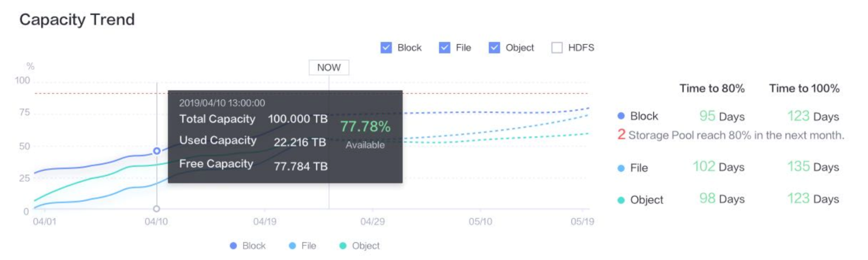
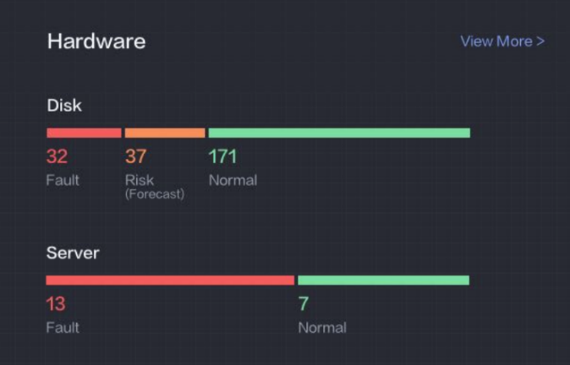
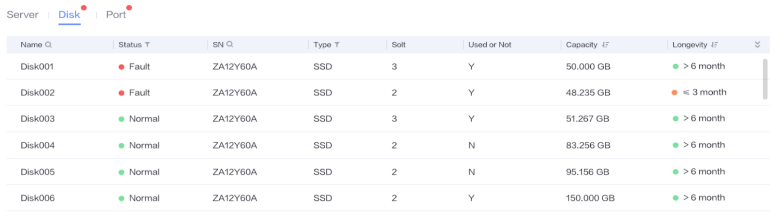
AI-based Forecast
1. eService uses massive data to train AI algorithms online, and mature algorithms are adapted to devices.
2. AI algorithms that do not require large-data-volume training are self-learned in the device.
eService
Capacity forecast
Run AI algorithms on devices based on historical capacity information to forecast risks one year in advance.
1
Result output
AI Algorithms
2
Risky disk forecast
Run AI algorithms on devices based on disk logs to forecast risks half a year in advance.
Data input
Disk information collection
Capacity collection
DISK

Slide 47
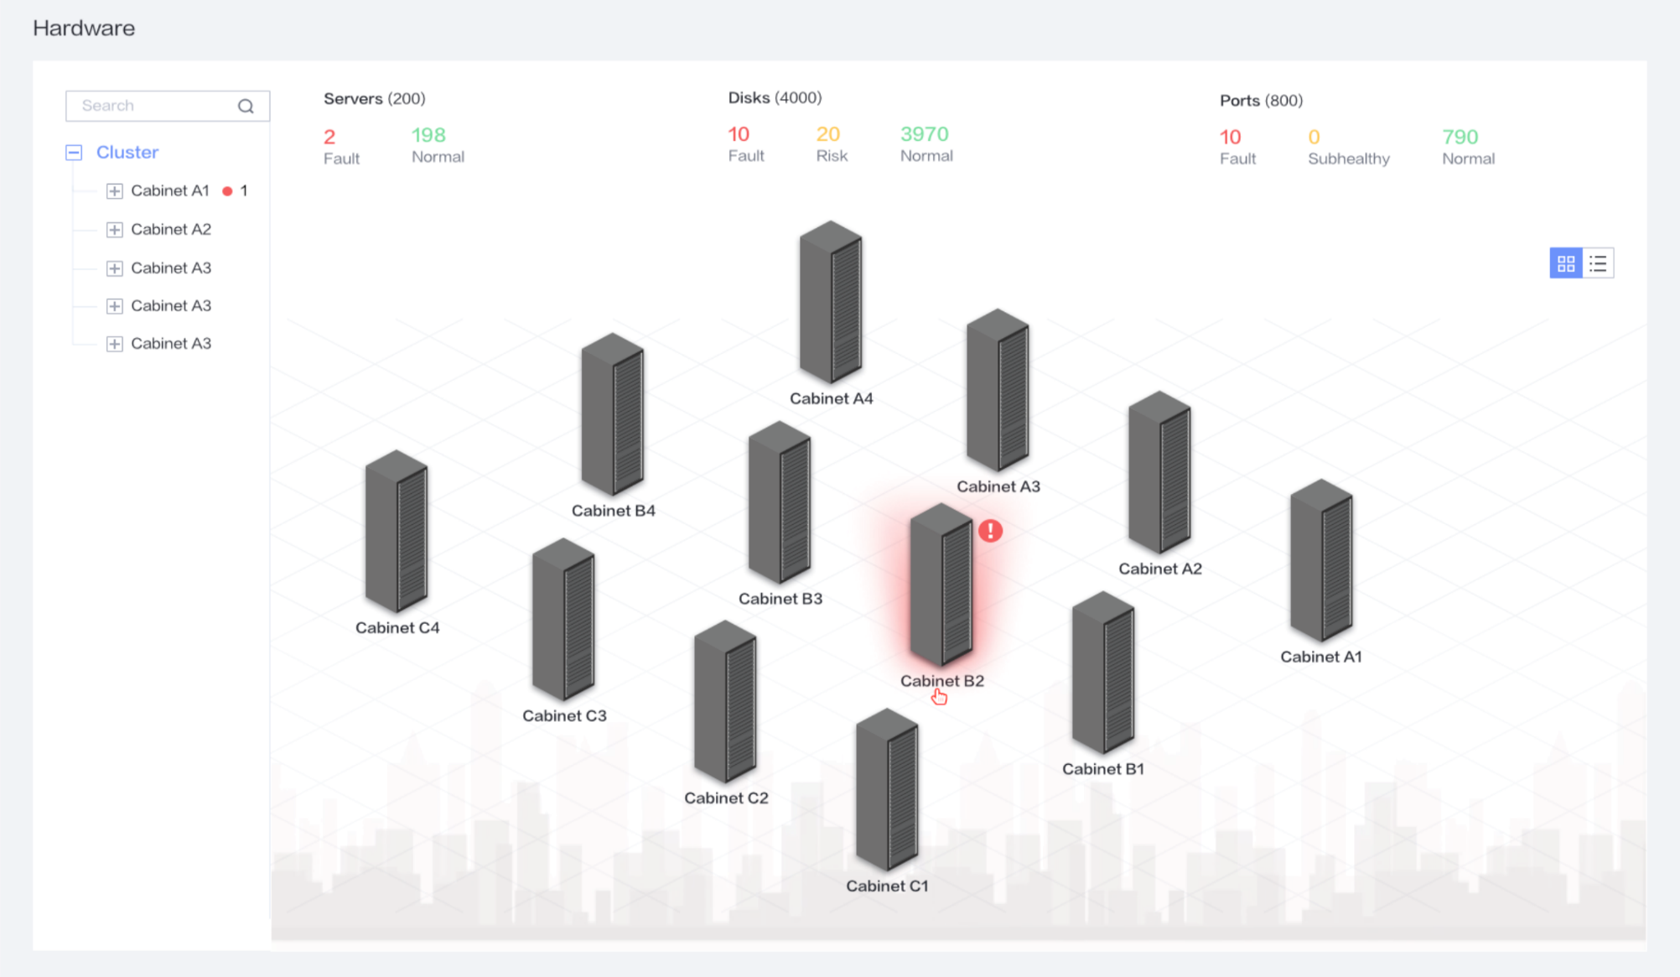
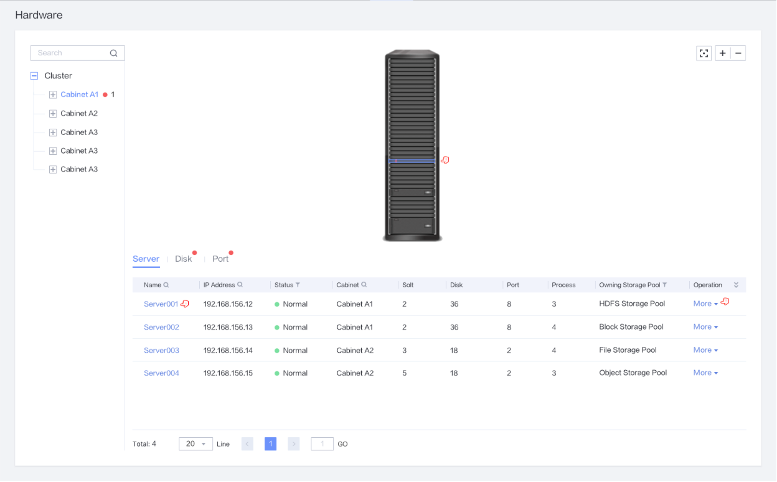
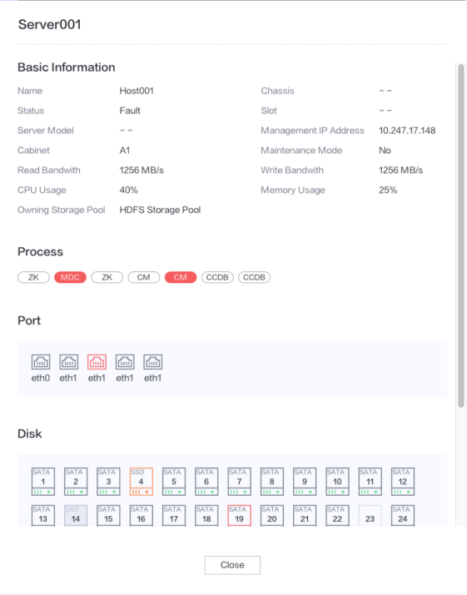
Hardware Visualization
Visualized hardware
Hardware-based modeling and layered display of global hardware enable second-level hardware fault locating.

Slide 48
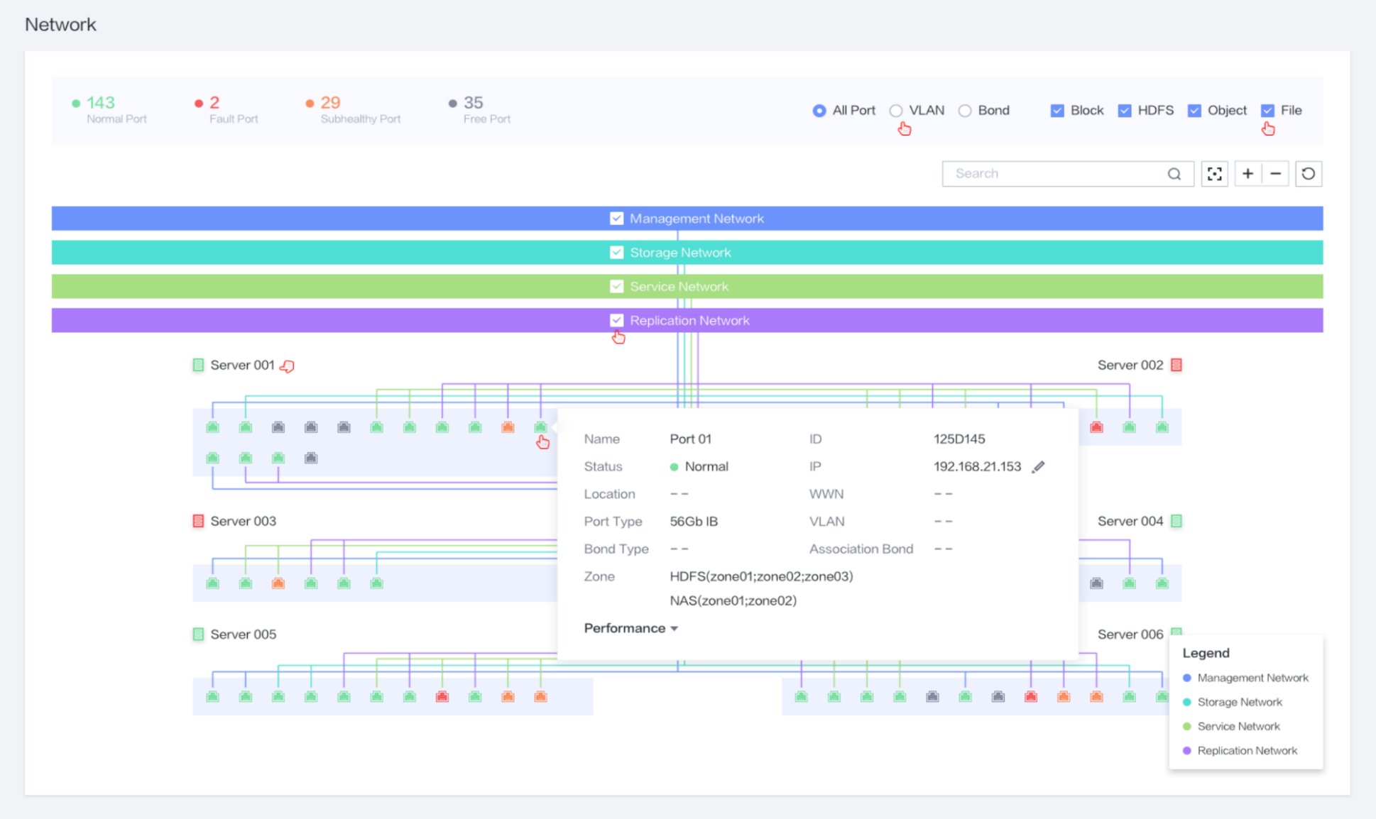
Network Visualization
Visualized networks
Based on the network information model, collaborative network management is achieved, supporting network planning, fault impact analysis, and fault locating.
The network topology can be displayed by VLAN and service type, facilitating unified network planning.
Network visualization displays network faults, subhealth status, and performance, associates physical network ports, presents service partitions, and helps customers to identify the impact scope of faults or subhealth for efficient O&M.

Slide 49

Three-Layer Intelligent O&M
Data Center
eService Cloud
OceanStor DJ
Storage resource control
Smartkit
Storage service tool
eSight
Storage monitoring and management
eService
Resource provisioning
Service planning
Delivery
Upgrade
Troubleshooting
Fault monitoring
Performance report
Intelligent maintenance platform
Intelligent analysis platform
Log analysis
Inspection tool
Storage subnet topology
Correlation analysis and forecast
HDFS maintenance Platform
REST
REST/CLI
REST/SNMP/IPMI
OceanStor 100D
https/email
Remote monitoring
Troubleshooting
DeviceManager
Single-device management software
Asset management
Capacity forecast
TAC/GTAC expert
CLI
Single-device management software
Health evaluation
Automatic work order creation
AAA
Deployment
Upgrade
Scale-in/out
Capacity forecast
Cluster management
Massive maintenance data
Global knowledge base
R&D expert
Monitoring
Configuration
Inspection
License management
Risky disk forecast
Service management

Slide 50
OceanStor 100D
Block+File+Object+HDFS
Ultimate Performance
Ultimate Usability
Scenario and Ecosystem
Overview
Ultimate Efficiency
Ultimate Reliability
Hardware
Ecosystem

Slide 51
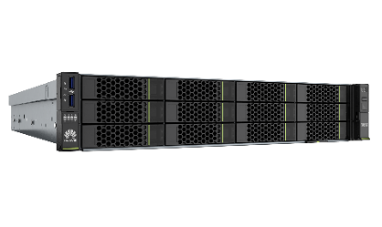



Flexible and General-Purpose Storage Nodes
Kunpeng series
x86 series
TaiShan 200(Model 2280) 2 U rack storage node:
2*Kunpeng 920 CPU
12/25 Slot Disk or 24 Slot NVMe
GE / 10GE / 25GE / 100 Gbit/s IB
2288H V5 2 U rack storage node:
2*X86 CPU
12/25 Slot Disk or 24 Slot NVMe
GE / 10GE / 25GE / 100 Gbit/s IB
TaiShan 200(Model 5280) 4 U rack storage node:
2*Kunpeng 920 CPU
36 Slot Disk
GE / 10GE / 25GE / 100 Gbit/s IB
5288 V5 4 U rack storage node:
2*X86 CPU
36 Slot Disk
GE / 10GE / 25GE / 100 Gbit/s IB
Name | Node | Node Type | Hardware Platform
OceanStor 100D | C110 | Capacity | 5288 V5
 | C100 |  | TaiShan 200 (Model 5280)
 | P110 | Performance | 2288H V5
 | P100 |  | TaiShan 200 (Model 2280)
 | F110 | Flash | 2288H V5
 | F100 | Flash | TaiShan 200 (Model 2280)

Slide 52

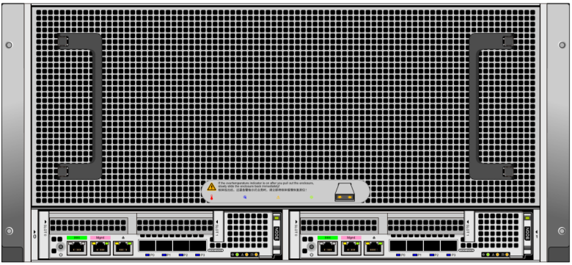

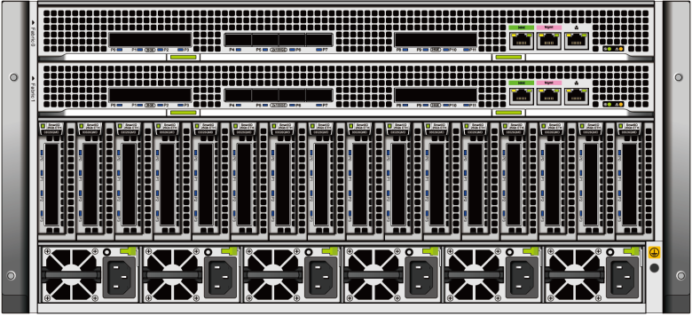
New-Generation Distributed Storage Hardware
Front view
Rear view
High-density HDD
(Pacific)
5 U, 2 nodes, 60 HDDs per node, 120 HDDs in total
Two I/O cards per node, four onboard 25GE ports
High-performance all-flash
(Atlantic)
5 U, 8 nodes, 10 SSDs per node, 80 SSDs in total
Two I/O cards per node, a total of 16 I/O cards
Two switch boards, supporting eight 100GE ports and eight 25GE ports

Slide 53
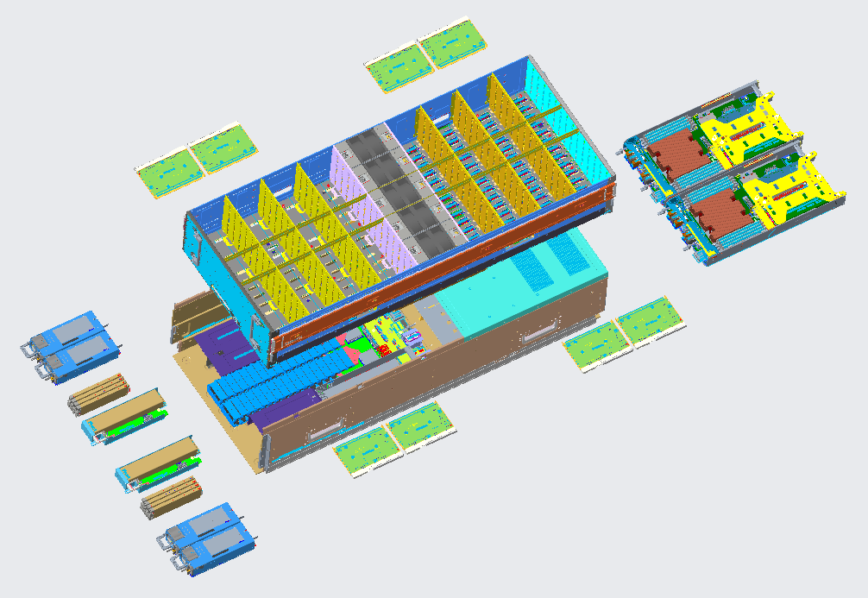
Pacific Architecture Concept: High Disk Density, Ultimate TCO, Dual-Controller Switchover, High Reliability, Smooth Data Upgrade, and Ever-New Data
Two nodes with 120 disks provide 24 disk slots per U, with industry-leading density and the lowest TCO per disk slot in the industry.
The dual-controller switchover design of vnode eliminates data reconstruction in the case of controller failures, ensuring service continuity and high reliability.
FRU design for entire system components, independent smooth evolution for each subsystem, one entire system for ever-new data
1*
GE
PCIe card
PCIe card
4*
25G
PCIe card
PCIe card
4*
25G
1*
GE
Controller
FAN
BMC
1620
1620
BMC
SAS/PCIE
SAS/PCIE
PWR
Power supply unit
BBU
Fan module
System disk
Exp
Exp
Exp
Exp
Exp
Exp
Exp
Exp
System disk
Power supply unit
BBU
Fan module
SSD
HALFPALM
HALFPALM
HALFPALM
HALFPALM
HALFPALM
HALFPALM
HALFPALM
HALFPALM
BBU
Expander
X15
X15
X15
X15
X15
X15
X15
X15
VNODE 1
VNODE 2
VNODE 3
VNODE 4
VNODE 5
VNODE 6
VNODE 7
VNODE 8

Slide 54
Pacific VNode Design: High-Ratio EC, Low Cost, Dual-Controller Switchover, and High Reliability
Vnode design supports large-scale EC and provides over 20% cost competitiveness.
If a controller is faulty, the peer controller of the vnode takes over services in seconds, ensuring service continuity and improving reliability and availability.
EC redundancy is constructed based on vnodes. Areas affected by faults can be reduced to fewer than 15 disks. A faulty expansion board can be replaced online.
Secondary controller service takeover in the case of a faulty controller
Vnode-level high-ratio EC N+2
Enclosure 1
Enclosure 2
Controller A
Controller B
Controller A
Controller B
PCIe card
PCIe card
4*
25G
PCIe card
PCIe card
4*
25G
X
Compute virtual unit
Compute virtual unit
Compute virtual unit
Compute virtual unit
1620
1620
VNODE
VNODE
VNODE
VNODE
VNODE
VNODE
VNODE
VNODE
VNODE
VNODE
VNODE
VNODE
VNODE
VNODE
VNODE
VNODE
SAS/PCIE
Single-controller SSD
Single-controller SSD
SSD
SSD
SSD
SSD
SSD
SSD
SSD
SSD
SSD
SSD
SSD
SSD
SSD
SSD
SSD
SSD
VNODE 1
VNODE 1
VNODE 1
VNODE 1
VNODE 1
VNODE 1
VNODE 1
VNODE 1
X
HALFPALM
HALFPALM
HALFPALM
HALFPALM
HALFPALM
HALFPALM
HALFPALM
HALFPALM
15 x HDDs
15 x HDDs
X15
X15
X15
X15
X15
X15
X15
X15
Dual-controller takeover
SAS
1. When a single node is faulty, SSDs are taken over by the secondary controller physically within 10 seconds, and no reconstruction is required. Compared with common hardware, the fault recovery duration is reduced from days to seconds.
2. The system software can be upgraded online and offline without service interruption.
3. Controllers and modules can be replaced online.
1. The SSDs of a single controller are distributed to four vnodes based on the expander unit. A large-ratio EC at the vnode level is supported.
2. At least two enclosures and 16 vnodes are configured. The EC ratio can reach 30+2, which is the same as the reliability of general-purpose hardware.
3. Expansion modules (including power supplies) and disk modules can be replaced online independently.

Slide 55
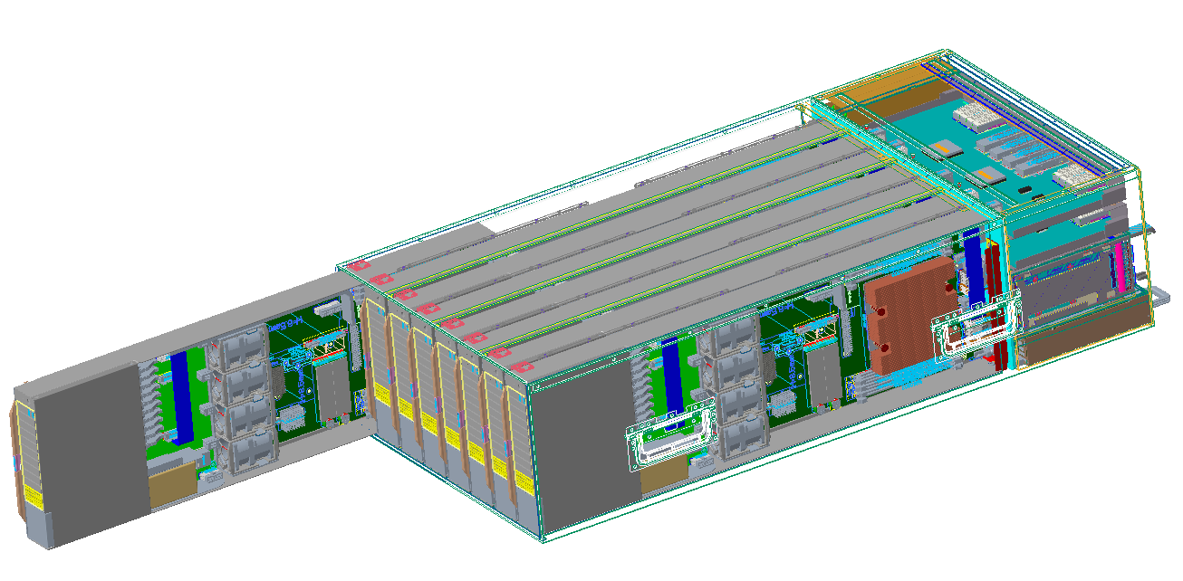

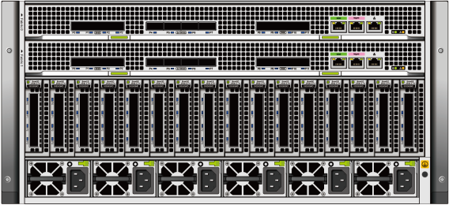
Atlantic Architecture: Flash Storage Native Design with Ultimate Performance, Built-in Switch Networking, Smooth Upgrade, and Ever-New Data
Flash storage native design: Fully utilize the performance and density advantages of SSDs. The performance can reach 144 Gbit/s and up to 96 SSDs are supported, ranking No.1 in the industry.
Simplified network design: The built-in 100 Gbit/s IP fabric supports switch-free Atlantic networking and hierarchical Pacific networking, simplifying network planning.
The architecture supports field replaceable unit (FRU) design for entire system components and independent smooth evolution for each subsystem, achieving one entire system for ever-new data.
Key Specifications | Requirements Specifications
System model | 5 U 8-node architecture, all-flash storage
Medium disk slot | An enclosure supports 96 x half palms.
Interface module | An enclosure supports 16 interface modules, compatible with half-height half-length standard PCI cards.
Switch | An enclosure supports two switch boards, eight controllers in the enclosure can be shared, and three enclosures can be connected without switches.
Node | A node supports one Kunpeng 920 processor, eight DIMMs, and 16 GB backup power.
I/O
I/O
I/O
I/O
I/O
I/O
I/O
I/O
Front view
Rear view
CPU
CPU
......
CPU
CPU
......
......
......
......
Built-in IP Fabric
Built-in IP Fabric

Slide 56
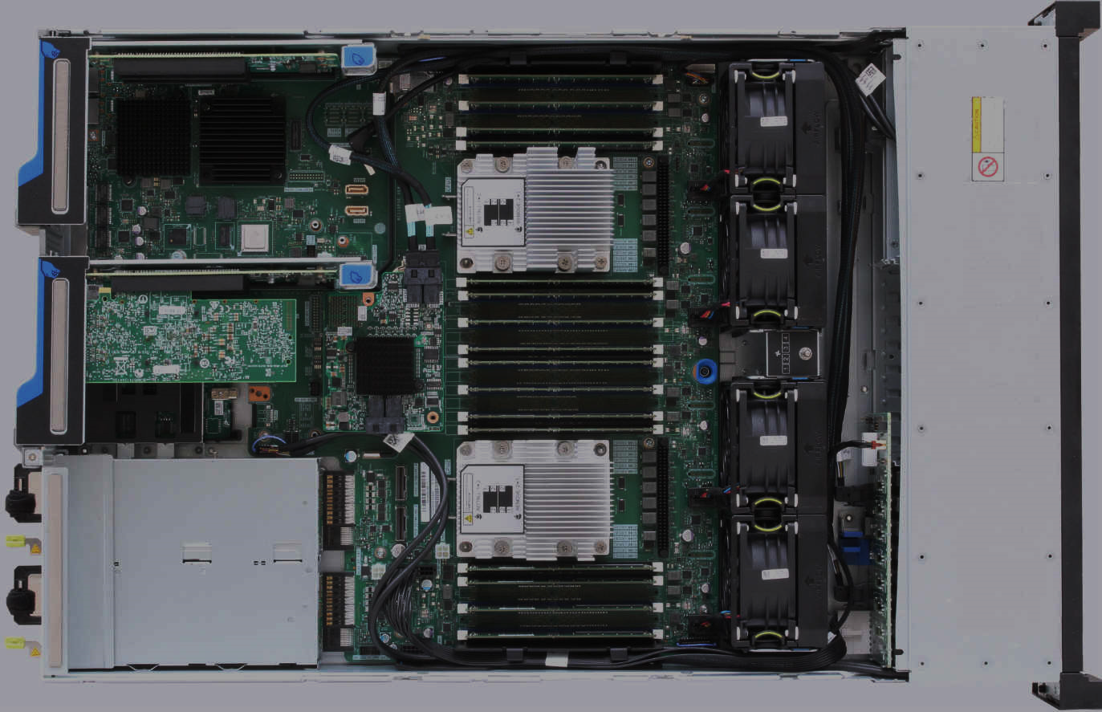
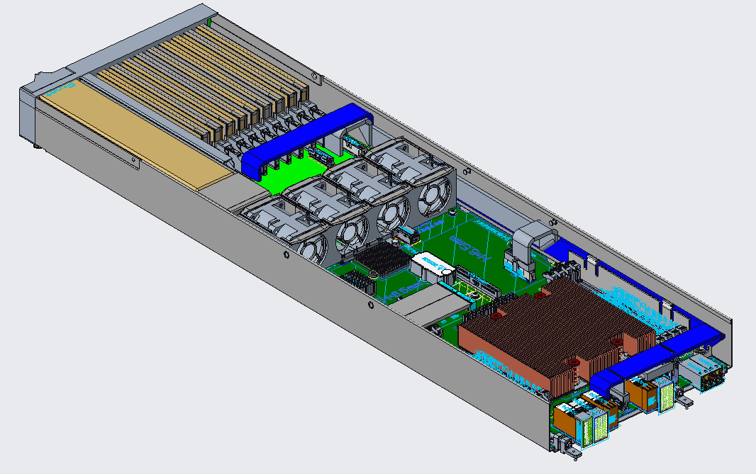

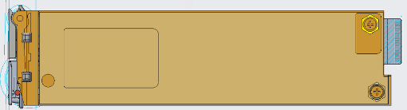



Native Storage Design of Atlantic Architecture
Native all-flash design:
Matching between compute power and SSDs: Each Kunpeng processor connects to a small number of SSDs to fully utilize SSD performance and avoid CPU bottlenecks.
Native flash storage design: Flash-oriented half-palm SSD with a slot density 50% higher than that of a 2.5' disk and more efficient heat dissipation
Traditional architecture design
Atlantic architecture is designed for high-performance and high-density application scenarios.
1. The ratio of CPUs to flash storage is unbalanced, causing insufficient utilization of the flash storage.
Half PALM SSD
1. The parallel backplane design improves the backplane porosity by 50% and reduces power consumption by 15%. The compute density and performance are improved by 50%.
2. A 2 U device can house a maximum of 25 SSDs, causing the difficulty in improving the medium density.
2. The half-palm design for SSDs reduces the thickness, increases the depth, and improves the SSD density by over 50%.
3. The holes on the vertical backplane are small, requiring more space for CPU heat dissipation.
3. Optimal ratio of CPUs to SSDs: A single enclosure supports eight nodes, improving storage density and compute power by 50%.
4. 2.5-inch NVMe SSDs are evolved from HDDs and are not dedicated to SSDs.

Slide 57
Atlantic Network Design: Simplified Networking Without Performance Bottleneck
4 nodes, 100GE per node
4 nodes, 100GE per node
Switch-free design:
24-node switch-free design eliminates network bandwidth bottlenecks.
With switch-free design, switch boards are interconnected through 8 x 100GE ports.
The passthrough mode supports switch interconnection. The switch board ports support the 1:1, 1:2, or 1:4 bandwidth aggregation ratio and large-scale flat networking.
BMC
6603
6603
Adopt the Pacific architecture to implement tiered storage.
4 x 25GE
4 x 25GE
24-node switch-free networking
Large-scale cluster switch networking
Atlantic
Atlantic
Atlantic
Atlantic
Atlantic
Atlantic
1620
1620
1620
1620
1620
1620
1620
1620
1620
1620
1620
1620
1620
1620
1620
1620
1620
1620
1620
1620
1620
1620
1620
1620
1620
1620
1620
1620
1620
1620
1620
1620
1620
1620
1620
1620
1620
1620
1620
1620
1620
1620
1620
1620
1620
1620
1620
1620
100GE
100GE
100GE
100GE
100GE
100GE
100GE
100GE
100GE
100GE
100GE
100GE
4*25GE
SD6603
4*50GE
SD6603
SD6603
4*50GE
SD6603
SD6603
SD6603
4*25GE
SD6603
4*50GE
SD6603
SD6603
4*50GE
SD6603
SD6603
SD6603
100GE
100GE
QSFP-DD
4 x 100GE
4 x 100GE
QSFP-DD
2 x 100GE
2 x 100GE
2 x 100GE
4 x 100GE
64 port 100GE Switch

Slide 58
OceanStor 100D
Block+File+Object+HDFS
Ultimate Performance
Ultimate Usability
Scenario and Ecosystem
Overview
Ultimate Efficiency
Ultimate Reliability
Hardware
Ecosystem

Slide 59

Block Service Solution: Integration with the VMware Ecosystem
Virtualization & Cloud Management
vCenterPlugin and VASA (Vvol) integration: provides vCenter-based integration management, enhances VVol-based QoS and storage profile capabilities, and supports VASA resource management in multiple data centers.
VMware vCloud Director
VMware vRealize
Operations
VMware vCenter Server
vROps (monitoring)
vCenter Plugin (storage integration management)
VASA (VVOL feature)
Integrates with vROps to provide O&M capabilities based on storage service performance, capacity, alarms, and topologies, implementing unified O&M management.
VMware vRealize
Orchestrator
vRO/vRA (workflow)
Rest
Rest
Enhances vRO & vRA integration and supports replication, active-active, snapshot, and consistency group capabilities based on OceanStor 100D 8.0.
VMware vCenter
Site Recovery Manager
SRM (DR)
OceanStor 100D
Interconnects with SRM to support replication, active-active switchover, switchback, and test drills and provides end-to-end solutions.
REST

Slide 60
Block Service Solution: Integration with OpenStack
OceanStor 100D Cinder Driver architecture:
OpenStack P release Cinder Driver API(Must Core-Function):
OpenStack
OpenStack P release
volume driver API | OceanStor 100D
create_volume | Yes
delete_volume | Yes
create_snapshot | Yes
delete_snapshot | Yes
get_volume_stats | Yes
create_volume_from_snapshot | Yes
create_clone_volume | Yes
extend_volume | Yes
copy_image_to_volume | Yes
copy_volume_to_image | Yes
attach_volume | Yes
detach_volume | Yes
initialize_connection | Yes
terminate_connection | Yes
Cinder API
OpenStack package
(OpenStack)
Cinder Scheduler
Cinder Volume
STaaS or eSDK
Rest API
OpenStack plugin
(Huawei-developed)
OceanStor 100D distributed storage
Applicable version:
Community Edition | Red Hat
OpenStack KiloOpenStack MitakaOpenStack NewtonOpenStack QueensOpenStack RockyOpenStack Stein | Red Hat OpenStack Platform 10.0

Slide 61
Block Service Solution: Integration with Kubernetes
Kubernetes Master
Process for Kubernetes to use the OceanStor 100D CSI plug-in to provide volumes:
The Kubernetes Master instructs the CSI plug-in to create a volume. The CSI plug-in invokes an OceanStor 100D interface to create a volume.
The Kubernetes Master instructs the CSI plug-in to map the volume to the specified node. The CSI plug-in invokes the OceanStor 100D interface to map the volume to the specified node host.
The target Kubernetes node to which the volume is mapped instructs the CSI plug-in to mount the volume. The CSI plug-in formats the volume and mounts the volume to the specified directory of the Kubernetes.
driver-register
CSI plugin
①
②
external-provisioning
Kubernetes Node
OceanStor 100D
driver-register
Container
SCSI/iSCSI
/mnt
external-attaching
CSI plugin
Block dev
③
CSI plug-in assistance service provided by the Kubernetes community
Kubernetes Node
Deployed on all Kubernetes nodes based on the CSI specifications to complete volume creation/deletion, mapping/unmapping, and mounting/unmounting.
CSI plugin
driver-register
external-attaching
Management plane
CSI plugin
Data plane

Slide 62
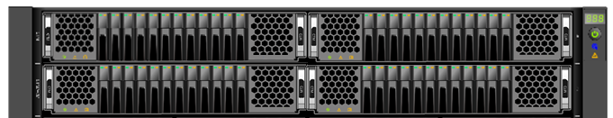
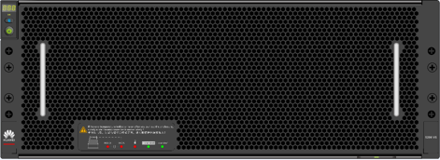
NAS HPC Solution: Parallel High Performance, Storage and Compute Collaborative Scheduling, High-Density Hardware, and Data Tiering
HPC Application
Compute Farm(50000+)
Parallel high-performance client
Compatible with POSIX and MPI-IO: Meets the requirements of the high-performance compute application ecosystem and provides the MPI optimization library to contribute to the parallel compute community.
Parallel I/O for high performance: 10+ Gbit/s for a single client and 4+ Gbit/s for a single thread
Intelligent prefetch and local cache: Supports cross-file prefetch and local cache, and meets high-performance requirements of NDP.
Large-scale networking: Meets the requirements of over 10,000 compute nodes.
Collaborative scheduling of storage and compute resources
Huawei scheduler: service scheduling and data storage collaboration, data pre-loading to SSDs, and local cache
QoS load awareness: I/O monitoring and load distribution avoid scheduling based on compute capabilities and improve overall compute efficiency.
High-density customized hardware
All-flash Atlantic architecture: 5 U, 8 controllers, 80 disks, 70 Gbit/s IOPS per enclosure @ 1.6 million IOPS
High-density Pacific architecture: 5 U 120 disks, supporting online maintenance and providing a high ratio EC to ensure high disk rate.
Back-end network free: With the built-in switch module, the back-end network does not need to be deployed independently if the number of enclosures is less than 3.
Data tiering for cost reduction
Single view and multiple media pools: Ensure that the service view will not be changed and applications will not be affected by the change.
Traditional burst buffer free: The all-flash optimized file system simplifies the deployment of a single namespace and provides higher performance especially for metadata access.
I/O Libraries
Parallel
Serial
......
MPI-IO
POSIX
Login & Job Scheduler
Parallel File System Client
Front-end network
OceanStor 100D File
Rack1
Rackn
Rackn+1
Rackm
...
...
SSD Pool
HDD Pool
Back-end network

Slide 63






HDFS Service Solution: Native Semantics, Separation of Storage and Compute, Centralized Data Deployment, and On-Demand Expansion
HDFS applications
HDFS applications
HDFS component
HDFS component
Hadoop compute cluster
Hadoop cluster
......
CPU
CPU
CPU
CPU
Management node
Memory
Memory
Memory
Memory
Compute nodes
Compute nodes
Compute node
Compute nodes
CPU
CPU
CPU
Memory
......
Native HDFS semantics
Management node
Memory
Memory
Storage system
Storage system
Storage system
Distributed storage cluster
Compute/Storage node
Compute/Storage node
Compute/Storage node
......
Based on the general x86 server and Hadoop software, a compute/storage node is used to access the local HDFS. The compute and storage resources can be expanded concurrently.
OceanStor 100D HDFS is used to replace the local HDFS of Hadoop. Using native semantics for interconnection, storage and compute resources are decoupled. Capacity expansion can be performed independently, facilitating on-demand expansion of compute and storage resources.

Slide 64








Object Service Solution: Online Aggregation of Massive Small Objects Improves Performance and Capacity
When the storage file object is smaller than the system strip, a large number of space fragments are generated, which greatly affects the space usage and access efficiency.
Object data aggregation
Obj1
Obj2
Obj3
Obj4
Obj5
Obj6
Incremental EC aggregates small objects into large objects without performance loss.
Reduce storage space fragments in massive small file storage scenarios, such as government big data storage, carrier log retention, and bill/medical image archiving.
Improve the space utilization of small objects from 33% (three copies) to over 80% (12+3).
SSD cache is used for object aggregation, improving the performance of a single node by six times (PUT 3000 TPS per node).
...
Strip1
Strip2
Strip3
Strip4
Parity 1
Parity 2
512K
EC 4+2 is used as an example.
Performs incremental EC after small objects are aggregated into large objects
SSD Cache
SSD Cache
...
...
......
Node 1
Node 2

Slide 65
Unstructured Data Convergence Implements Multi-Service Interworking
O&M Management
Scenario: gene sequencing/oil survey/EDA/satellite remote sensing/IoV
Scenario: log retention/operation analysis/offline analysis/real-time search
Scenario: backup and archival/resource pool/PACS/check image
Converged storage pool
Three types of storage services share the same storage pool, reducing initial deployment costs.
Multi-protocol interoperation
Multiple access interfaces for one copy of data, eliminating the requirement for data flow and reducing TCO
Shared dedicated hardware
One set of dedicated hardware can be used for flexible deployment of three types of storage services, compatible with hardware components of different generations, implementing ever-new data storage.
Co-O&M management
One management interface integrates multiple storage services, achieving unified cluster and O&M management.
NAS
HDFS
S3
Out of the box
Feature
Private client
Quota
Snapshot
Tiered storage
Asynchronous replication
Feature
Private client
Quota
Snapshot
Tiered storage
Rich ecosystem components
Feature
Metadata retrieval
Quota
3AZ
Tiered storage
Asynchronous replication
Intelligent O&M
FILE
HDFS
OBJECT
Ecosystem compatibility
Converged resource pool
Multi-protocol interoperation
Unstructured data base
Variable-length deduplication and compression
Storage and compute collaboration
Dedicated hardware
Low cost
Ultra-high capacity density: HDD nodes provide 24 disks per U.
High performance
High-density performance: All-flash nodes provide 20 Gbit/s per U.
High reliability
Dedicated hardware, fast sub-health isolation, and fast failover
Competitive hardware differentiation
Integrated software and hardware, non-volatile memory, Huawei-developed SSD and NIC, and customized distributed storage hardware increase differentiated competitiveness.
Notes:
Unstructured Data Convergence
Multiple servicers using FILE, HDFS and OBJECT storage can be located in the same storage pool, reducing initial deployment costs.
They use different interfaces for one copy of data, eliminating the requirement for data flow and reducing TCO.
Those services use one set of shared dedicated hardware for flexible deployment.
They use one management interface for unified management.
1) Converged storage pool
Three types of storage services share the same storage pool, reducing initial deployment costs.
2) Multi-protocol interoperation
Multiple access interfaces for one copy of data, eliminating the requirement for data flow and reducing TCO
3) Shared dedicated hardware
One set of dedicated hardware can be used for flexible deployment of three types of storage services, compatible with hardware components of different generations, implementing ever-new data storage.
4) Co-O&M management
One management interface integrates multiple storage services, achieving unified cluster and O&M management.

